Slide 1
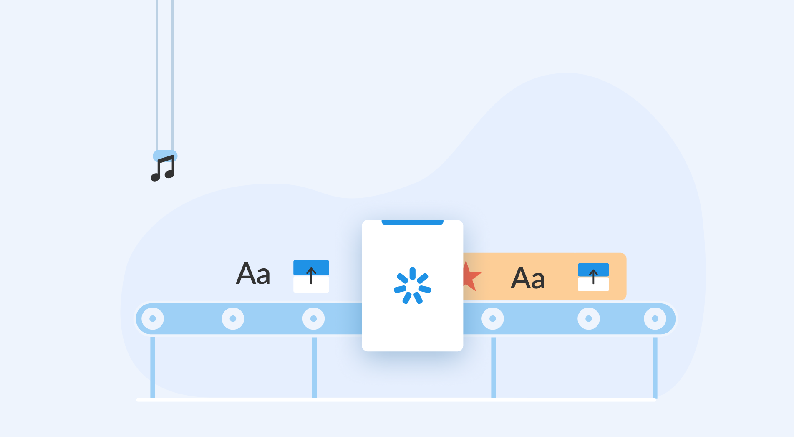
iSpring Conversion Technology Overview

Slide 2
iSpring Technology: PowerPoint Features Support
This presentation will introduce you all PowerPoint objects, animations and effects that iSpring converts to HTML5 with the highest accuracy.
All PowerPoint animation effects
All PowerPoint slide transitions
Animations by words and letters
Action buttons and hyperlinks
Text formatting, fonts, color, height
Lists and bullets
Tables and diagrams
Slide Masters
SmartArt objects
Slide notes styles
AVI/WMV/MPG/MP4 video clips
MP3, WAV and WMA audios
Background audio for a slide
Background audio for a presentation
Sounds for animation effects
Sounds for slide transitions
Vector and raster images
Animated GIF images
Shapes geometry and positioning

Slide 3

Click to view

Slide 5
Fall Over

Slide 7
Drape

Slide 9
Curtains

Slide 11
Wind

Slide 13
Prestige

Slide 15
Fracture

Slide 17
Crush

Slide 19
Peel Off

Slide 21
Page Curl

Slide 23
Airplane

Slide 25
Origami

Slide 27
Cut

Slide 29
Fade

Slide 31
Push

Slide 33
Wipe

Slide 35
Split

Slide 37
Reveal

Slide 39
Random Bars

Slide 41
Shape

Slide 43
Uncover

Slide 45
Cover

Slide 47
Flash

Slide 49
Dissolve

Slide 51
Checkerboard

Slide 53
Blinds

Slide 55
Clock

Slide 57
Ripple

Slide 59
Honeycomb

Slide 61
Glitter

Slide 63
Vortex

Slide 65
Shred

Slide 67
Switch

Slide 69
Flip

Slide 71
Gallery

Slide 73
Cube

Slide 75
Doors

Slide 77
Box

Slide 79
Comb

Slide 81
Zoom

Slide 83
Pan

Slide 85
Ferris Wheel

Slide 87
Conveyor

Slide 89
Rotate

Slide 91
Window

Slide 93
Orbit

Slide 95
Fly Through

Slide 97
Morph

Slide 98
Morph

Slide 100
Animations: Entrance Effects
Appear
Peek in
Faded swivel
Spinner
Fold
Blinds
Plus
Faded zoom
Stretch
Glide
Box
Random bars
Ascend
Unfold
Light speed
Checkerboard
Split
Center revolve
Zoom
Magnify
Circle
Strips
Color typewriter
Boomerang
Pinwheel
Crawl in
Wedge
Compress
Bounce
Sling
Diamond
Wheel
Descend
Credits
Spiral in
Dissolve in
Wipe
Ease in
Curve up
Swish
Flash once
Expand
Grow & turn
Flip
Swivel
Fly in
Fade
Rise up
Float
Thread
Whip

Slide 101
Animations:
Entrance Effects
Exit Effects
Disappear
Peek out
Faded swivel
Spinner
Fold
Blinds
Plus
Faded zoom
Collapse
Glide
Box
Random bars
Descend
Unfold
Light speed
Checkerboard
Split
Center revolve
Zoom
Magnify
Circle
Strips
Color typewriter
Boomerang
Pinwheel
Crawl out
Wedge
Stretchy
Bounce
Sling
Diamond
Wheel
Ascend
Credits
Spiral out
Dissolve out
Wipe
Ease out
Curve down
Swish
Flash once
Contract
Grow & turn
Flip
Swivel
Fly out
Fade
Rise down
Float
Thread
Whip

Slide 102
Animations: Emphasis Effects
Change fill color
Color Wave
Vertical Highlight
Change font color
Complementary Color
Flicker
Grow/Shrink
Complementary Color 2
Shimmer
Transparency
Contrasting Color
Teeter
Spin
Darken
Blast
Change line color
Desaturate
Blink
Brush On Color
Flash Bulb
Color Blend
Lighten

Slide 103
Animations: Basic Motion Path Effect
4 Point Star
Diamond
Parallelogram
5 Point Star
Equal Triangle
Pentagon
6 Point Star
Football
Right Triangle
8 Point Star
Heart
Square
Circle
Hexagon
Teardrop
Crescent Moon
Octagon
Trapezoid

Slide 104
Animations: Line & Curve Motion Paths
Arc Down
Decaying Wave
S Curve 1
Turn Down Right
Arc Left
Diagonal Down Right
S Curve 2
Turn Up
Arc Right
Diagonal Up Right
Sine Wave
Turn Up Right
Arc Up
Down
Spiral Left
Up
Bounce Left
Funnel
Spiral Right
Wave
Bounce Right
Heartbeat
Spring
Zigzag
Curvy Left
Left
Stairs Down
Curvy Right
Right
Turn Down

Slide 105
Animations: Special Motion Paths
Bean
Curvy Star
Inverter Triangle
Plus
Buzz Saw
Figure 8 Four
Loop de Loop
Pointy Star
Curved Square
Horizontal Figure 8
Neutron
Swoosh
Curved X
Inverter Square
Peanut
Vertical Figure 8

Slide 106

Animations: Custom Motion Path
Custom Motion Path

Slide 107



Animations: Words and Letters, Repeat, Combination
Animations by words
and letters
Animation effects combination
Repeating animation effects
Fly in
Spin
Fly in and Spin

Slide 108




Animations: Advanced Animation Techniques

Slide 109


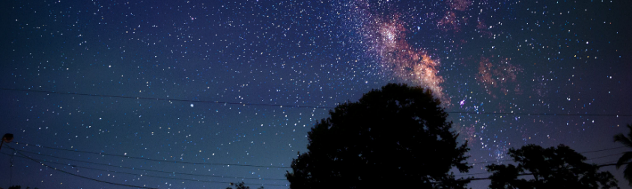

Animations: Trigger Animation Effect
Click here
Click here
Click here
Click here

Slide 110
Advanced Text Formatting
Regular text
Bold text
Underlined text
Shadowed text
Text of multiple styles, fonts, sizes, and colors
Various styles of bullets:
Picture bullets
Numbered bullets
Character bullets

Slide 111
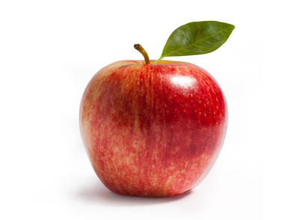
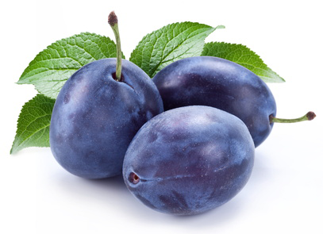
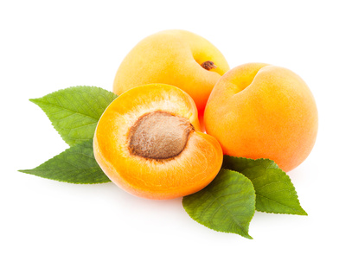
Basic PowerPoint Objects
Vector shapes
Raster images
Circle
Star
Pie
Clouds
Lines

Slide 112
Tables
Student name | Math score | Physics score
John Smith | 69% | 88%
Bill White | 82% | 74%
Steven Black | 97% | 100%
William Green | 16% | N/A

Slide 113
Diagrams and SmartArt
Animals
Birds
Eagle
Sparrow
Fishes
Shark

Slide 114
Advanced Effects
Original
3D Rotation + Perspective
+ Emboss
Original
Shadow + 3D
Word Art Text Effects
Word Art Text Effects

Slide 115
Geometry and Positioning: Connectors
1
3
2

Slide 116
Precise Shapes Conversion and Positioning
Heart
Down
Ribbon
Callout
Star

Slide 117
Hyperlinks
Existing File or Web Page
Previous Slide
Place in this document
Next Slide

Slide 118



Sound Objects

Slide 119

Video Objects

Slide 120



Mobile Device Support
iOS
Android
Windows Phone

Slide 121






Supports All Modern Browsers

Slide 122

Thanks for your attention!
View Again

